Slide 1
Figures for Nature paper
Anderson and Presnall

Slide 2
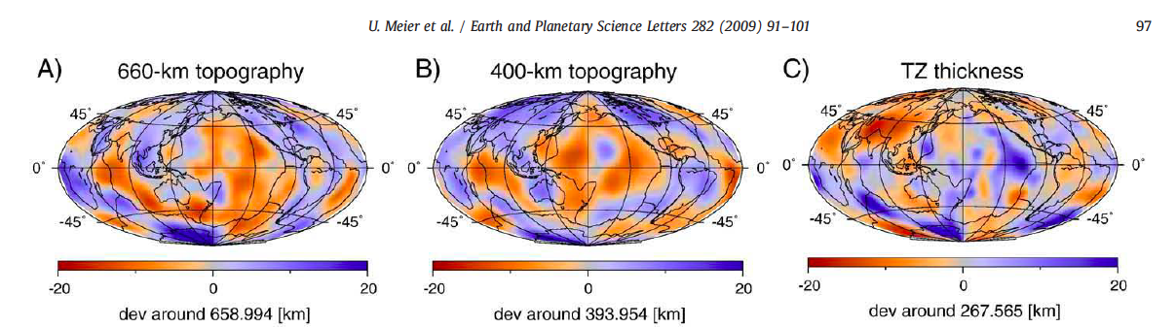
Depths of 410 and 650 are generally correlated. Anticorrelations, which are expected for thermal effects, occur along S. EPR, PAC-ANT Rise, far S. Pacific. One way to have correlated depths is for cold slabs to bottom out at 650 km and displace hotter material upwards.
The combination of cold and water from the slab may also be involved. If slabs have always bottomed out at 650 then it will be a former phase boundary that is now a chemical boundary (eclogite over pv). Topography in this case is now sensitive to loads as well as T.
Notes:
U. Meier et al. / Earth and Planetary Science Letters 282 (2009) 91–101. Global variations of temperature and water content in the mantle transition zone
from higher mode surface waves
U. Meier a,⁎, J. Trampert a, A. Curtis

Slide 3
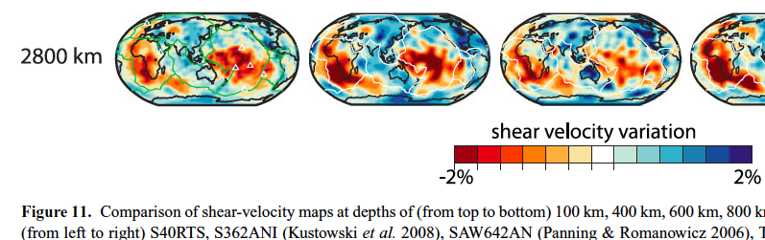
The BL at the base of the mantle is highly variable in thickness and properties, in contrast to the constant thickness of Region B
Notes:
Ritsema; Model interpretation is often focused on the continuity of slabs
and the presence of plumes in the mantle.However, the tomographic
models from Fig. 11 disagree even at scales much larger than subducting
slabs and rising plumes, demonstrating that the seismic
structure of the transition zone and lower mantle is still inconsistently
imaged. Model differences stem from choices in data processing
and modelling approaches.

Slide 4
The evidence for “cold” subridge mantle includes;
Depressed residual bathymetry
Bathymetric gradient away from ridges (“seafloor flattening”)
Seismic velocity gradients away from ridges toward plate interiors
Elevated 410 under ridges
Thick TZ under younger parts of oceans
High seismic wavespeeds below 200 km
Notes:
MORB doesn’t represent ambient mantle

Slide 5
The integrated density under ridges is high
RIDGE MANTLE IS COLD !
Seafloor flattening is due to lateral density gradients below 200 km

Slide 6
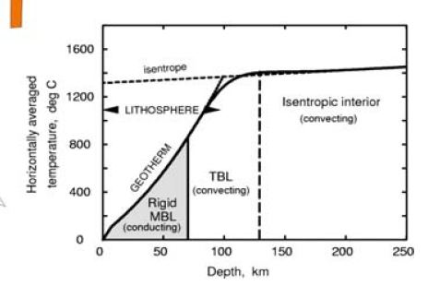
1600
1200
midplate
Ridge adiabat
Boundary layer
T
ºC
LLAMA(shearing)
Plate (conducting)
Depth
Notes:
FIGURE ; Schematic geotherms for ambient midplate mantle and cold near-ridge upwellings

Slide 7
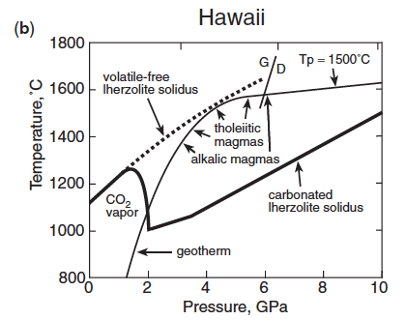
Ambient mantle subadiabat
MORB extraction
From MORB source
Boundary layer geotherm overlying ambient mantle

Slide 8
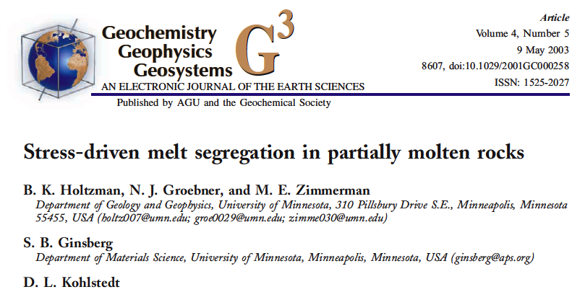
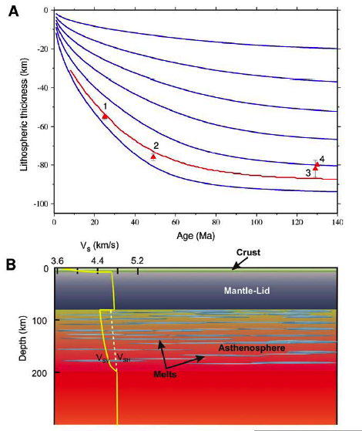
Science 24 April 2009:
Vol. 324. no. 5926, pp. 499 - 502
DOI: 10.1126/science.1169499
Prev | Table of Contents | Next
REPORTS
Seismic Evidence for Sharp Lithosphere-
Asthenosphere Boundaries of Oceanic Plates
Hitoshi Kawakatsu,Prakash Kumar, Yasuko Takei,Masanao Shinohara,Toshihiko Kanazawa, Eiichiro Araki, Kiyoshi Suyehiro
The key papers
Melt-rich layers

Slide 9
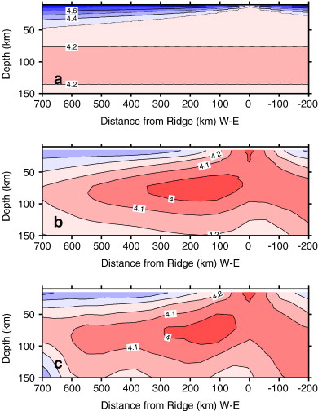
Sub-ridge mantle is “cold”
theoretical
observed
Thermal gradient
Notes:
Fig. 6. Shear velocity models from the conductive cooling model (a), polynomial model (b), and the isochron model (c). Positive distance from the ridge is the Pacific plate and negative distance is the Nazca plate.

Slide 10
+
  2000
  1800
  1600
  1400
  1200
  1000
  800
  600
  400
  200
Geotherms
x
The surface boundary layer, Gutenberg’s Region B, is thicker and hotter than in standard petrological models.
OIB sources
Hawaii
MORB adiabat
MORB
Stein & Stein
Temperature (K)
Hofmeister
Parsons & Sclater
Critical gradient
0 20 40 60 80 100 120 140 150
150
Depth (km)
Notes:
Why are ridge basalts cold?...ridge mantle is cold and ambient geotherms in an internally heated mantle are subadiabatic. The deeper the source the lower the Tp.

Slide 11
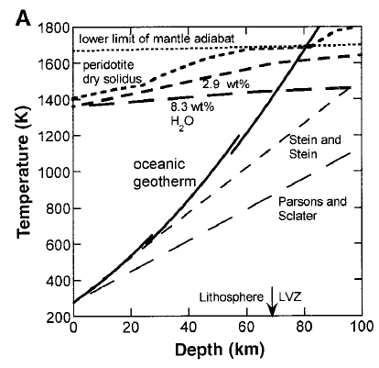
25 K/km
8 K/km

Slide 12
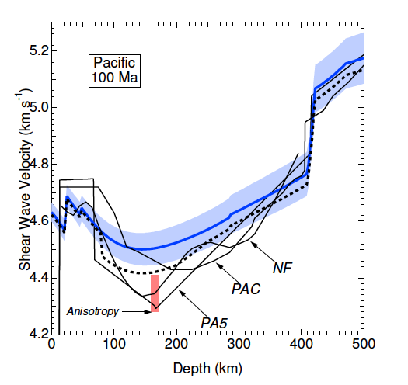
Notes:
The average thermal gradient down to 150 km depth has to be 50 % larger than assumed in Stixrude to explain the actual observed LVZ and at depth can be 3 times the shallow gradient because of temperature effects, for the same heatflow.

Slide 13
1600
1200
midplate
Ridge adiabat
Boundary layer
T
ºC
LLAMA(shearing)
Plate (MBL) (conducting)
Depth
Notes:
FIGURE ; Schematic geotherms for ambient midplate mantle and cold near-ridge upwellings

Slide 14
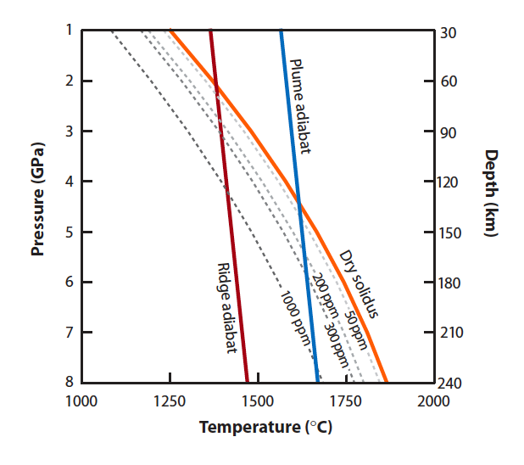
OIB adiabat
Carbonated-solidus
Max Hawaii source depth
Base of surface boundary layer
H₂0

Slide 15
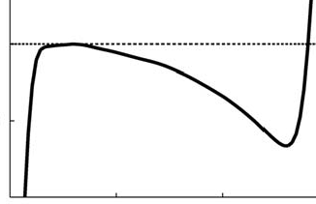
~1300 C
~1500 C
B
Tp
Ridge geotherm
No boundary layer
depth
Hawaii
>300 km
ridge
D”
distance
Notes:
FIGURE : Vertical and lateral T gradients

Slide 16
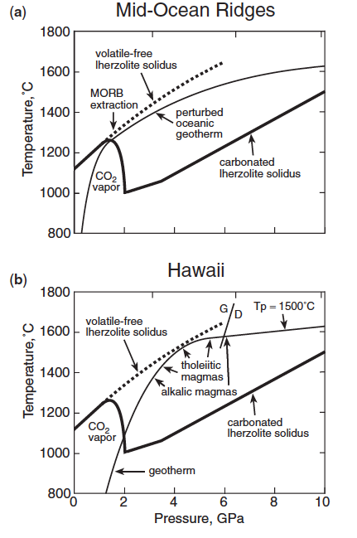
Adiabatic ascent from as deep as the TZ
cold
MORB
MORB source
Subridge mantle is colder and denser than midplate mantle so the upwelling adiabat starts at lower Tp
Sub-ridge geotherm
x
subadiabat
No upwelling required for OIB since ambient BL geotherm is above the volatile bearing geotherm
x
x
OIB source & extraction
Notes:
FIGURE 1
An adiabat drawn from ~8 GPa or deeper and which arrives at the surface in the temperature range inferred for MORB will intersect the carbonated solidus at roughly the boundaries of the LVZ. Such a cold adiabat can originate in the transition region because of the subadiabatic nature of the geotherm in the presence of internal heating (Jeanloz, Morris, Moore). The inflection of the solid adiabat due to melting may decrease the temperature by about 100 C by the time that it arrives at the surface.
MOR and midplate geotherms do not converge on the same adiabat as assumed by McK&B and McK& Priestley

Slide 17
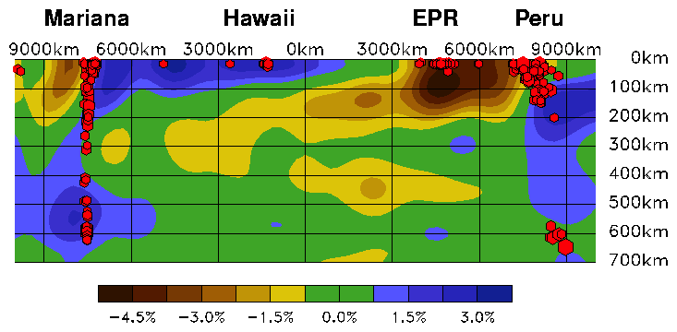
cold warm cool cold
Notes:
FIGURE 2
There are lateral gradients in seismic wavespeeds away from ridges that are consistent with relatively cold subridge mantle below 200 km depth. The proximity of the East Pacific Rise (EPR) to the Peru-Chile subduction zone may also contribute to cold mantle under the EPR. In any case, subridge mantle cannot be assumed to represent ambient subplate mantle.

Slide 18
ridge
Intraplate volcanoes
lithosphere
G
Lid
G
LVL
LL
from TZ
from TZ
DMM
Notes:
Figure ; The boundary layer model for intraplate volcanoes. Intraplate volcanoes tap into (narrow arrows) melt-rich zones (red) in the BL while midocean ridges are fed from below the boundary layer(wide arrows) via spreading induced
upwellings and upsside-down drainage below the BL...

Slide 19
ridge
Intraplate volcanoes
lithosphere
G
Lid
G
Ambient mantle
LVL
LL
from TZ
from TZ
DMM
Notes:
Figure ; The boundary layer model for intraplate volcanoes. Intraplate volcanoes tap into (narrow arrows) melt-rich zones (red) in the BL while midocean ridges are fed from below the boundary layer(wide arrows) via spreading induced
upwellings and upsside-down drainage below the BL...

Slide 20
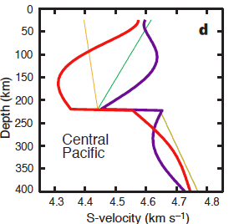
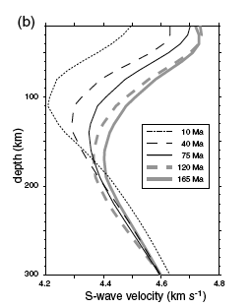
S-velocity vs age & depth
Isotropic inversions yield much thicker and higher wavespeed lids and more extreme LVZs
“cold” ridge mantle
Shapiro & Ritzwoller
Notes:
Shapiro & Ritzwoller
FIGURE 4
Shapiro & Ritzwoller
Note that mantle under 10 Ma plates has higher Vs than mantle under >40 Ma plates. The Vs under young plates increases rapidly with depth below 100 km so that Vs exceeds Vs under older plates by a depth of 180 km. Below 150 km depth the slowest regions of the mantle are not under 10 Ma, or 40 Ma crust but under 120 Ma, and 75 Ma crust. Mantle under 165 Ma crust is intermediate in seismic properties.
Note that below 220 km mantle under 10 Ma plates has higher Vs than mantle under >40 Ma plates. The Vs under young plates increases rapidly with depth below 100 km so that Vs exceeds Vs under older plates by a depth of 180 km.
Negative velocity gradient implies large superadiabatic (conduction) thermal gradient

Slide 21
nomenclature
Crust
LID
220 km
410
650
1000
Lower
Mantle
CMB
A
B’
B”
C’
C’’
D’
D”
BL
Gutenberg’s Region B
Moho to 220 km
G
L
Potential temperature, Tp
LVL
Subadiabatic geotherm
Tp
Note: Tp in D” is not necessarily higher than in B
Bullen’s Region D”
BL
Notes:
FIGURE 1: Nomenclature of the mantle.The boundary between Regions B and C differs between Gutenberg (1959) and Bullen (1947 ). Gutenberg placed the boundary near 220 km while Bullen placed it near 410 km. The 650 km discontinuity was unknown at the time. The lower mantle (Region D) starts below 900 or 1000 km. The Transition Region was defined originally as the mantle between 410 and ~900 km. The Transition Zone (TZ) was later assigned to the regions between 410 and 650 km.The low-velocity anisotropic layer (LLAMA) extends from the Gutenberg discontinuity (G) to the Lehmann discontinuity (L). A schematic potential temperature (Tp) geotherm is shown, along with Boundary Layers (BL). The adiabatic interior of McK&B is replaced by an internally heated region that develops a subadiabatic gradient.

Slide 22
The variation of VSV & VSH show that high thermal gradients extend to >200 km & melt content is max at ~150 km
Melt content
geotherm
VSV
100
Depth (km)
T
VSH
f
200
Based on Shapiro & Ritzwoller
I
I
I I
1000 1500 2000
4 5
Temperature (K)
S-wave velocity (km/s)
Key concepts; high thermal gradient plus laminated fabric
Eliminate the melt lenses & you have a craton!
Notes:
FIG, 4: schematic geotherm, melt content and simplified VSV and VSH vs depth (Shapiro & Ritzwoller, ). Horizontally propagating S-waves, VSH, are mainly controlled by the velocities of the solid olivine-rich layers and their T and P derivatives. SV waves are mainly controlled by the low velocity melt rich layer or low-rigidity lamellae.
[ -.2 to -3 km/s per 100 km for shear wave gradient; 10 to 14 o/km used by Stixrude]

Slide 23
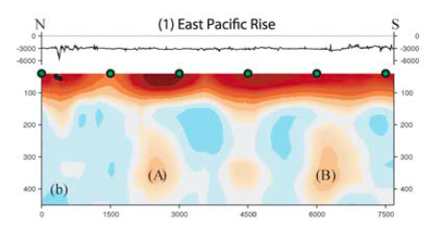
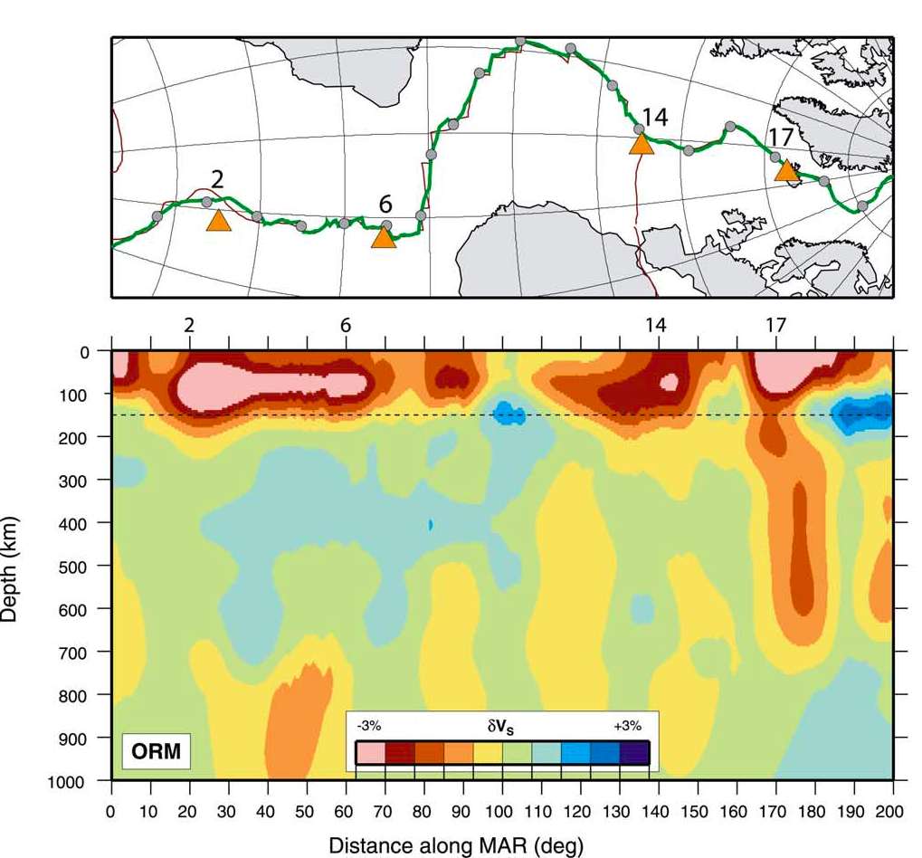
Some ridge segments extend into the TZ
Notes:
Ritsema and Allen.Maggi

Slide 24
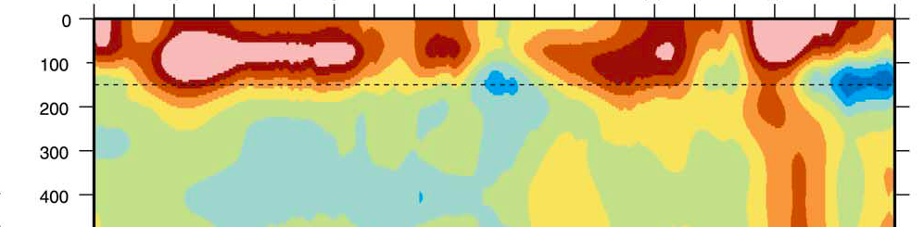
Some ridge segments extend to >400 km implying that the source for ridge basalts may be in the TZ. The VSV>VSH anisotropy below ridges is consistent with this
East Pacific Rise
depth
Galapagos
Easter
100
200
300
400
100
200
300
400
Tristan Ascension Azores Iceland
100
200
300
400
Mid-Atlantic Rise
Notes:
(D) Cross-section along
the MAR (green line) illustrating that the strongest shear velocity anomalies are located beneath the ridge hotspots (triangles).
Circles on the MAR and corresponding ticks on the tomogram are spaced 10‡ apart. The 2nd, 6th, and 14th ticks coincide with
the Tristan, Ascension Island, and Azores hotspots. Low shear velocities beneath Iceland (17th tick) extend into the upper mantle
transition zone.

Slide 25
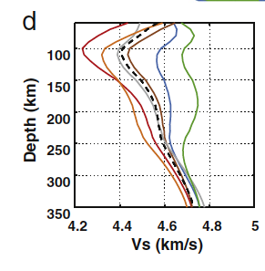
Negative velocity gradient implies large superadiabatic (conduction) thermal gradient
Depth(km/s)
Depth
100
200
300
100
200
300
Age (Ma)
10
75
165
4.2
Vs (km/s)
4.8
Near-ridge mantle
4.2 4.8
Vs (km/s)
Shapiro & Ritzwoller
Lekic & Romanowicz
Notes:
Shapiro & Ritzwoller
Note that below 220 km mantle under 10 Ma plates has higher Vs than mantle under >40 Ma plates. The Vs under young plates increases rapidly with depth below 100 km so that Vs exceeds Vs under older plates by a depth of 180 km. Below 150 km depth the slowest regions of the mantle are not 10 Ma, or 40 Ma crust but 120 Ma, and 75 Ma crust.165 Ma is intermediate.
20 Ma crust and less has high velocities below 150 km !

Slide 26
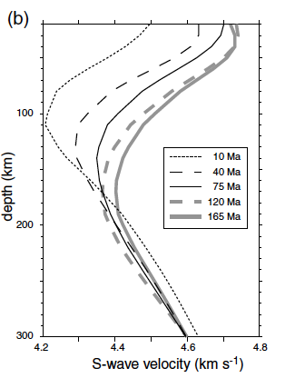
0 Ma
+0.28 km/s
165 Ma
100 km
-0.32 km/s
-0.04 km/s
+0.08 km/s
230 km

Slide 27
motion
Residual bathymetry
Vs decreases
0 Ma
>100 Ma
100 km
+0.28 km/s
Axis of LVZ
-0.32 km/s
Base of shear boundary layer
-0.04 km/s
230 km
-0.08 km/s
Shear velocity decreases
“410” km discontinuity

Slide 28
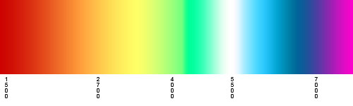
lithosphere
LID
LVZ
LEHMAN
1000
1500
1500
1450
1-
3 %
Thermal max
asthenosphere
⁰C
% Melt
Gutenberg Region C
Tp
Notes:
FIGURE
9. Schematic showing distribution of melt and potential temperatures based on anisotropic surface wave seismology

Slide 29
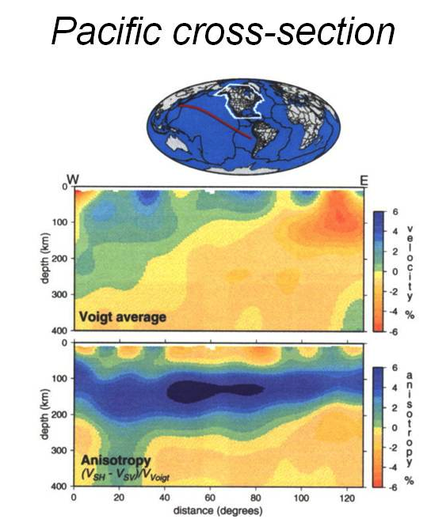
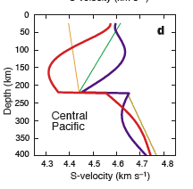
The sign of the anisotropy implies lateral flow in the central Pacific above 200 km and vertical flow beneath ridges extending to > 400 km (see also NewTOE)
LID
VSV
VSH
Vs
High polarization anisotropy occurs between 50 and 200 km depth and is about 4000 km wide in the central Pacific
Ekstrom, Nettles, Dziewonski
Notes:
Polarization anomaly
Anisotopy suggests upward flow under young plates, vertical cracks?

Slide 30
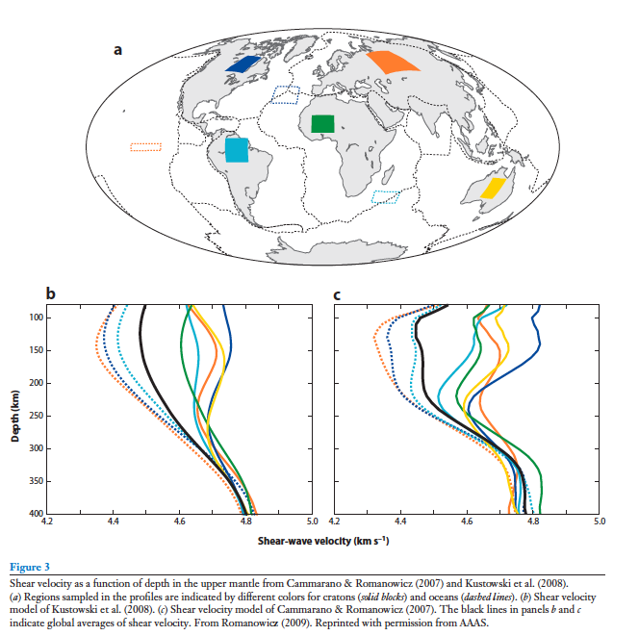
For some reason all UCB models terminate at 70 km. Perhaps because when anissotropy inversion is done, there is no lid!

Slide 31
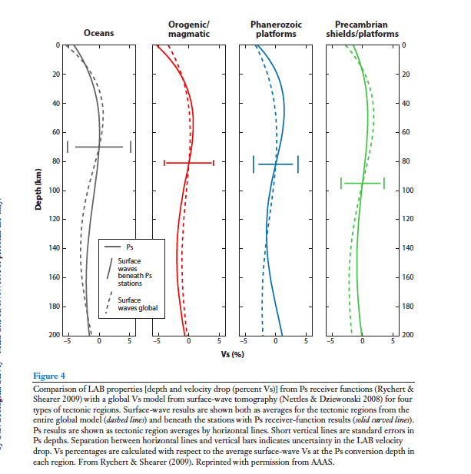

Slide 32
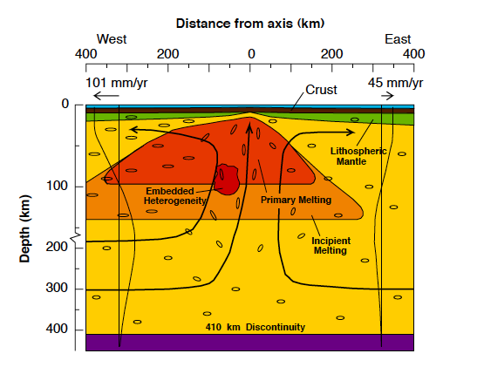
Towards hotter
cold
Notes:
MELTS Team
Although melt is extracted under ridges from shallow depth the bulk of the material is derived from below 200 km (The Melt Seismic Team, 1998).

Slide 33
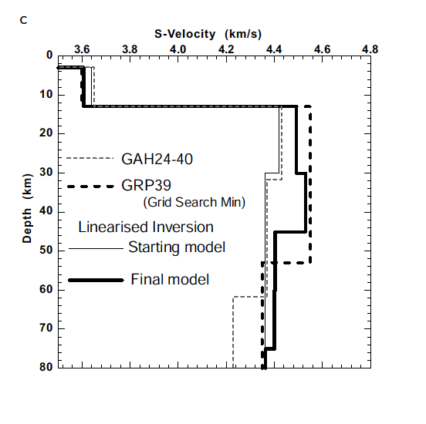
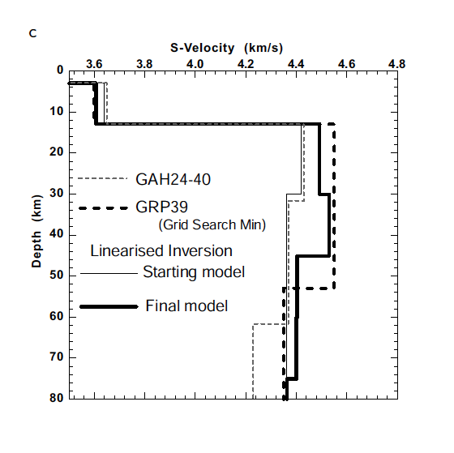
Iceland
No anomaly
Notes:
Iceland, Tilman

Slide 34
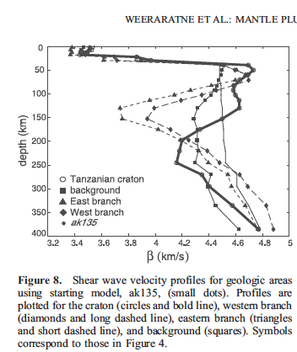
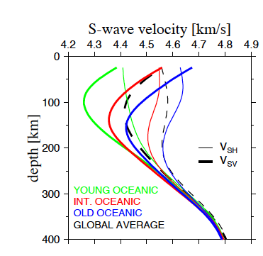
Notes:
Modeling the anisotropic shear-wave velocity structure in the Earth’s
mantle on global and regional scales
A thesis presented
by
Bogdan Kustowski
to
The Department of Earth and Planetary Sciences
in partial fulfillment of the requirements
for the degree of
Doctor of Philosophy
in the subject of
Geophysics
Harvard University
Cambridge, Massachusetts
January, 2007

Slide 35
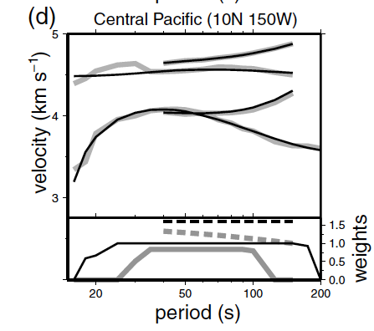
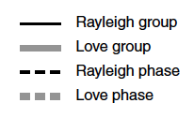
Laske
Notes:
Shapiro & Ritzwoller

Slide 36
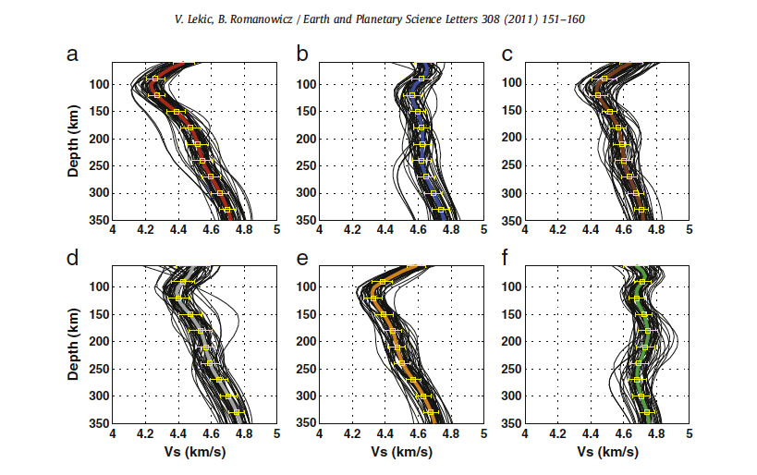
Notes:
Note how lid is masked out. This is the case for all UCB models.

Slide 37
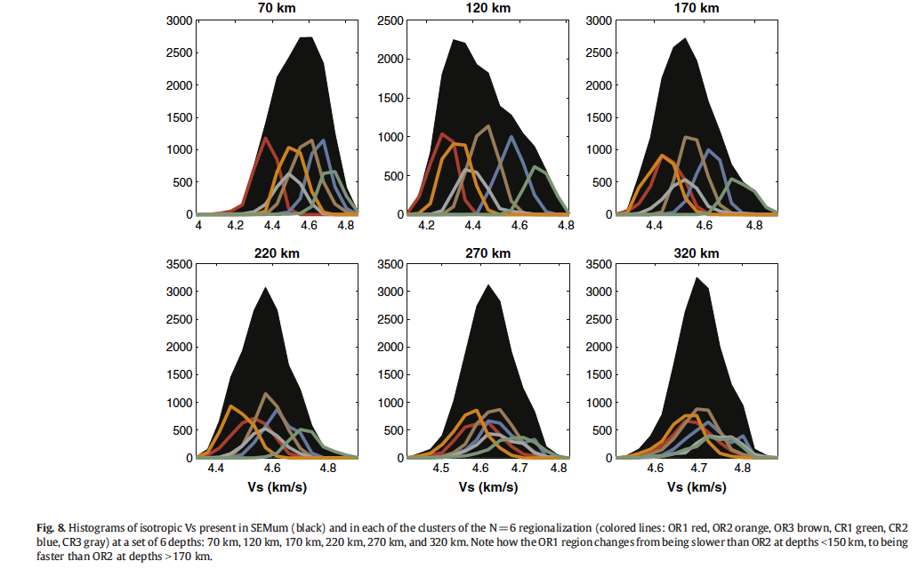
Notes:
Fig. 8. Histograms of isotropic Vs present in SEMum (black) and in each of the clusters of the N=6 regionalization (colored lines: OR1 red, OR2 orange, OR3 brown, CR1 green, CR2
blue, CR3 gray) at a set of 6 depths: 70 km, 120 km, 170 km, 220 km, 270 km, and 320 km. Note how the OR1 region changes from being slower than OR2 at depths b150 km, to being
faster than OR2 at depths N170 km.

Slide 38
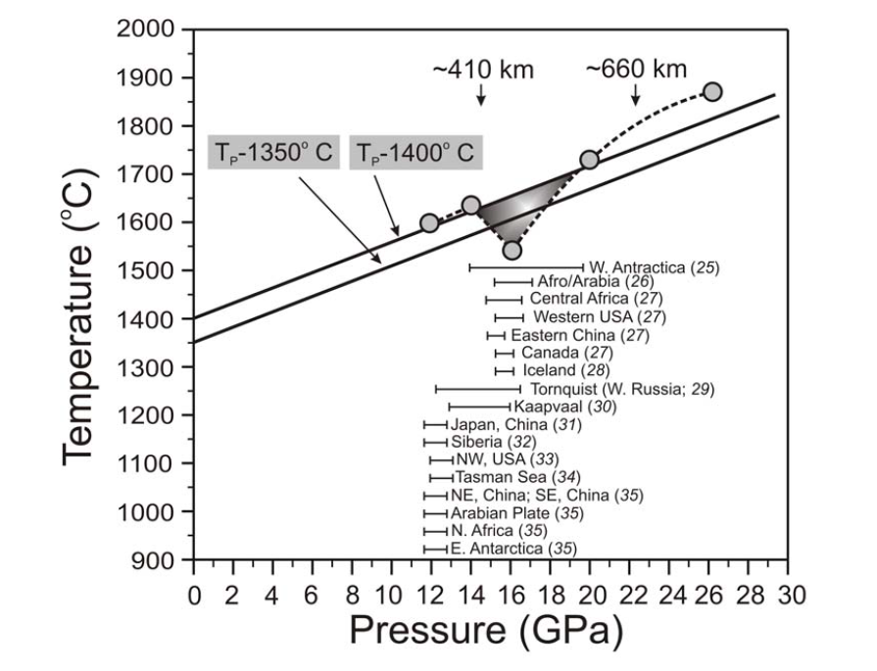
-30 C/30 GPa
x
-0.33 C/km
x
Notes:
4. Seismically detected low-velocity zones (LVZ) projected onto the solidus of model carbonated peridotite in the CMS-CO² system (from Fig. 2). Two adiabats with a potential temperature (Tp) of 1400 and 1350ºC, and a gradient of 13ºC/GPa (24) are shown. There are two types of deep low-velocity zones shown in this figure. Some of these low-velocity zones appear to be restricted to a fairly narrow depth range, ~350-600 km, corresponding almost exactly to where the solidus of carbonated peridotite abruptly drops, causing enhanced melting. This zone of enhanced melting is shown as a roughly triangular region shaded in grey. In addition to the low-velocity zones found in the transition zone, there are a few others that have been detected at an approximate depth of ~ 350-370 km. All the low-velocity zones are projections onto this P-T diagram, and hence, have nothing to do with the vertical axis representing temperature.

Slide 39
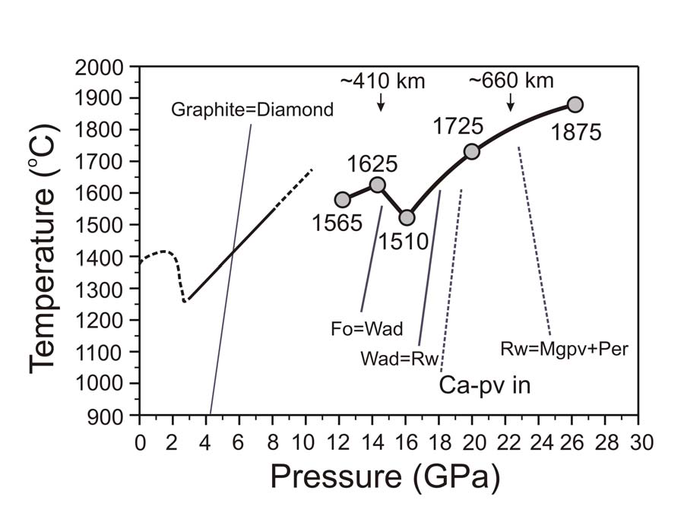
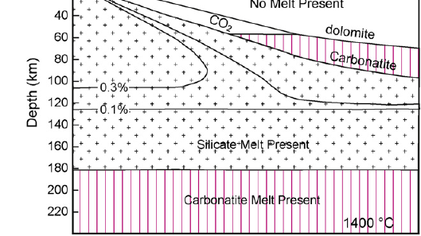

Slide 40
island arc basalts
backarc basin basalts
underplate
Sheared boundary layer

Slide 41
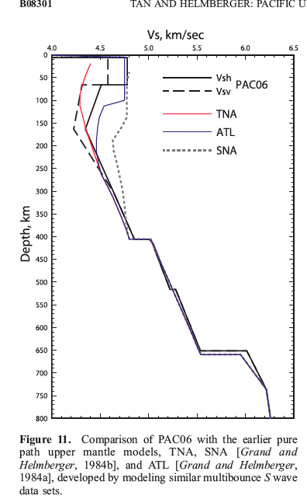
Most of the delay & lateral variability of teleseismic travel times are in the upper 220 km of the mantle
If this plus the anisotropy in this region is ignored, the result is plume-like structure* in the deep mantle
*artifact

Slide 42
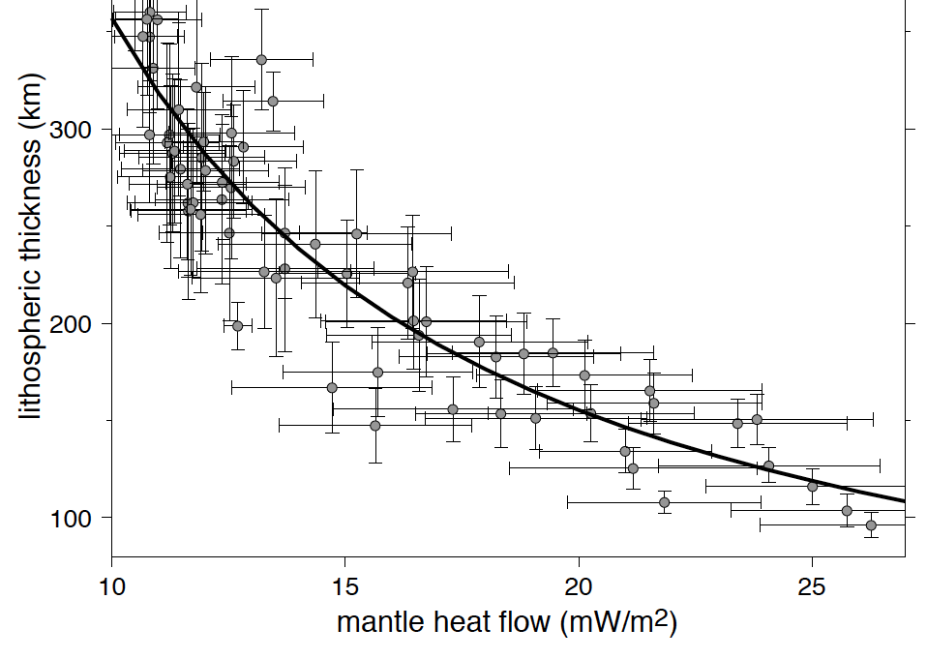
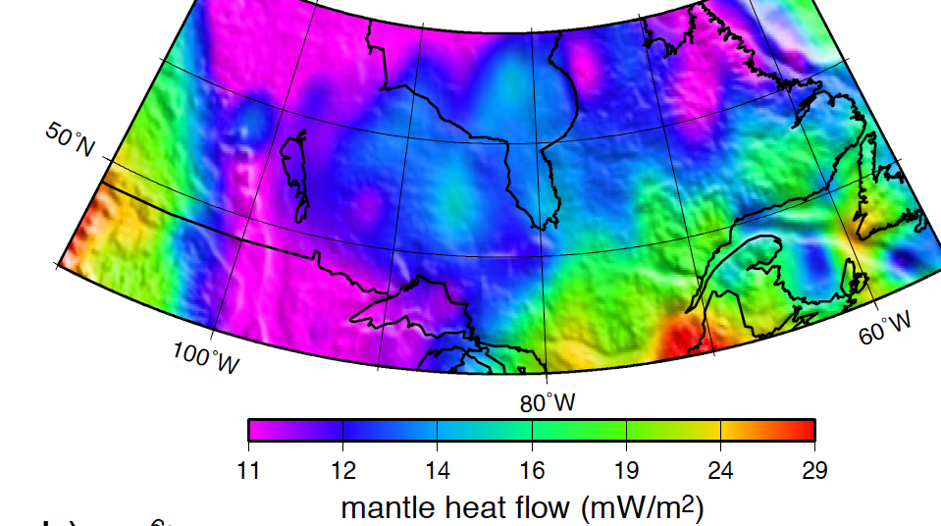
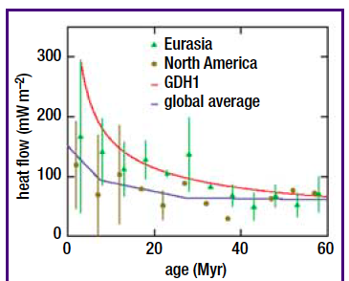
Notes:
Canada
Iceland heatflow

Slide 43
ridge
Tp
Introduce plums
sheared plums
200
400
km
UPPER MANTLE
SUBDUCTION-FED ASTHENOSPHERE

Slide 44
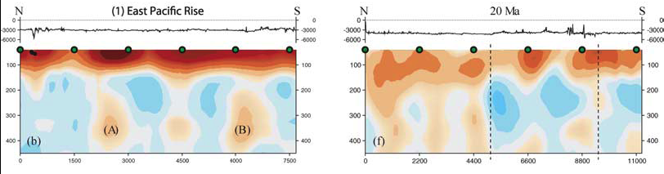
Hawaii mantle has high seismic velocities
HAWAII
anisotropy
fast
Slow direction
slow
Slow direction
fast
2-3 sec delays
Maggi

Slide 45
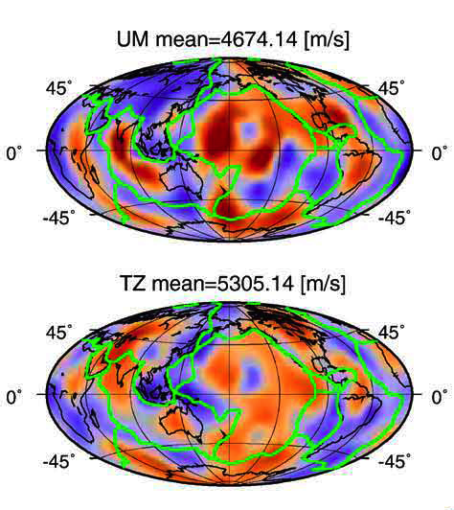
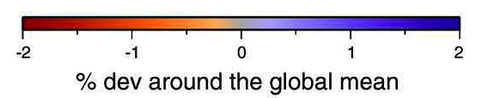
CPSA
Upper mantle is bluer under ridges
Long wavelength global variations ~ 4 %
Hawaii is not a “hotspot” !
Transition Zone
410-650 km
Notes:
Meier et al., Higher modes 2009
Central Pacific is locally fast around Hawaii. Africa is normally anomalous!
We took a different approach and performed a nonlinear joint
inversion for velocity structure and transition zone discontinuities using
surfacewave overtone measurements of Rayleigh waves up to the sixth
higher mode and of Lovewaves up to the fifth highermode (Visser et al.,
2008a), data never before employed in studies ofmantle discontinuities.
As opposed to fundamental mode surface waves that are mostly
sensitive to the upper 200 km, sensitivities of higher mode surface
waves extend well into the lower mantle and make them especially
suitable for mantle tomography (e.g. Ritsema et al., 2004; Visser et al.,
2008b). We inverted these measurements using a neural network
approach to obtain full Bayesian posterior probability density functions
(pdfs) for the depth of the 400- and 660-km discontinuities, the
transition zone thickness, aswell as S-wave velocity, averaged over three
different depth ranges in the upper mantle.

Slide 46
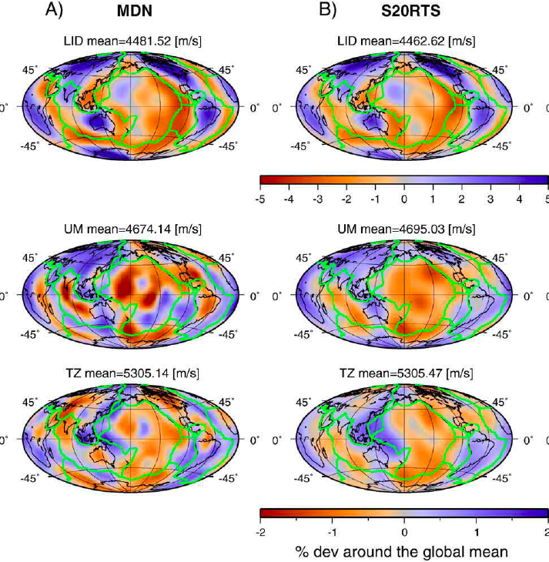
Notes:
Meier lots of higher modes plus Monte Carlo & non linear inversion FIGURE 4

Slide 47
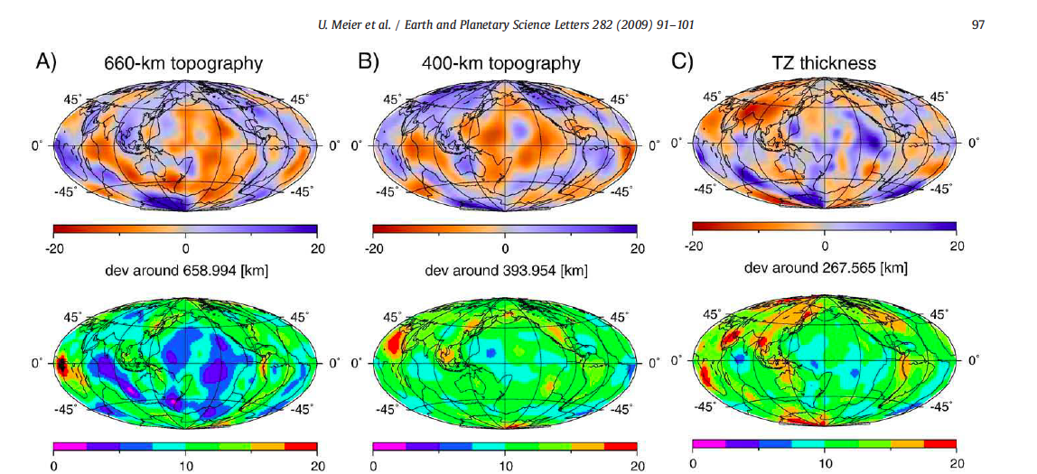
Fully nonlinear joint inversion of surface wave overtones for velocity
and topography of TZ discontinuities …models are compared with linearized inversions…agreement between vertically averaged Vs and 650-km depths is good, 400-km topography is poor… minerals may co-exist with water & CO₂ induced melt.
Notes:
Meier. FIGURE 5. Globally we find a positive correlation between our 660- and 400-km
topography (Fig. 5B), indicating that not only thermal effects influence
the discontinuity topography. In specific areas, such as near the
subduction zones in eastern Asia and underneath South America we
observe a depression in both the 660-, and the 400-kmtopography. Over
large parts of the Pacific ocean on the other handwe observe an uplift in
both the 660- and the 400-km topography. A similar observation was
made beneath South America, where a depression in both the 400- and
660-km topography has been reported

Slide 48
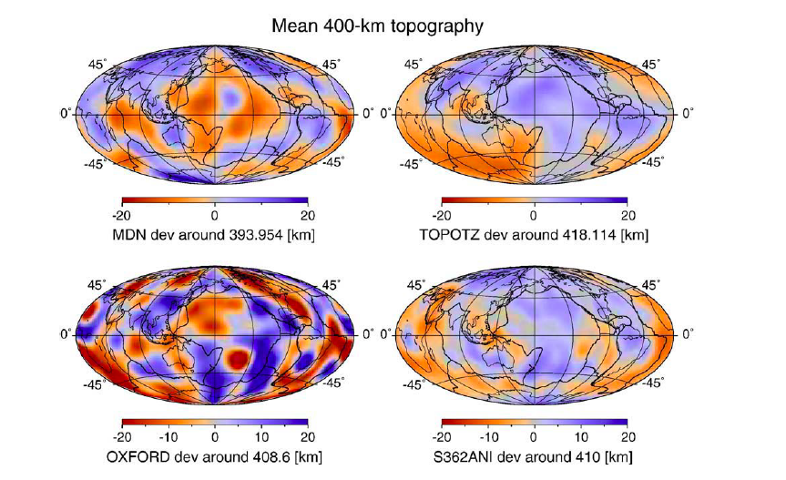
Notes:
Meier

Slide 49
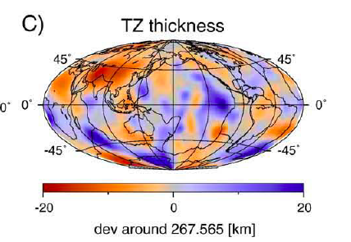
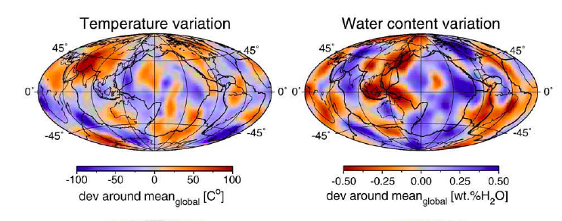
The low temperatures that are inferred to exist under ridges from their seismic velocities and residual depths are also evident, on average, in the thickness of TZ.
TZ
Notes:
U. Meier et al. / Earth and Planetary Science Letters 282 (2009) 91–101
Meier FIGURE 5 & 9. Inferred temperatures near midocean ridges in the C.Atlantic, far S. Atlantic, N.EPR, the Indian ocean ridge system and under BAB are cold, some 50-100 Coder than most midplate locations

Slide 50
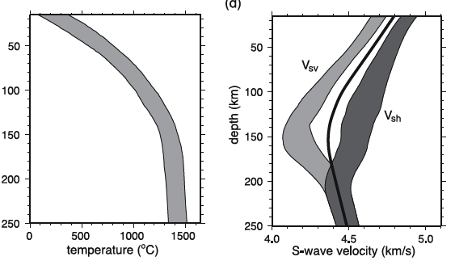
Average Pacific; Ritzwoller

Slide 51

Average Pacific; Ritzwoller

Slide 52


Canadian Shield
Shapiro
4.2 Tanzania
New criteria for plume; Vs <4.4km/s at 200 km depth
Notes:
The observation of low-velocity zones beneath
cratonic lithosphere is not uncommon. Seismic tomography
studies for the Kaapvaal craton [Green et al. , 1992;
Cichowicz and Green , 1992; Freybourger et al. , 2001;
Saltzer , 2002], the Canadian Shield [Grand and Helmberger ,
1984], and the Australian shield [Simons et al. , 1999]
indicate negative gradients in the velocity profile associated
with the transition from high-velocity cratonic lithosphere to
global average mantle at greater depths. The low-velocity
anomalies below these lithospheric roots, however, do
not reach shear wave velocities below 4.4 km/s. By comparison,
the dramatic excursion to b = 4.20 ± 0.05 km/s
at 200–250 km below the surface of the Tanzanian craton
is unique. These velocities are lower than velocities found
at comparable depths beneath the East Pacific Rise spreading
center [Nishimura and Forsyth , 1989] and require unusually
high temperatures and perhaps partial melting that may
be associated with the spreading of a mantle plume head.

Slide 53

Notes:
Nishimura and Forsyth

Slide 54
FAST START MODEL (HARE)
MORB-parent (popping rock) is ³He-rich. High ³He/⁴He can also be from ³He-poor parents
Most of the decrease in ³He/⁴He ratios occurs in the first 1.5 Gyr. There is little change since 3 Ga
Rapid decay in U-, Th-rich and/or gas poor mantle
Slow decay in gas-rich or U,Th-poor mantle
Shallow perisphere
MORB reservoir-Transition Zone?
Porcelli & Pepin 2008
Notes:
Fig. 3.ﾊThe evolution of closed system reservoirs. The ³He/⁴He ratio in mantle material with a U concentration of 21ﾊppb that has been closed for U, Th, and He is shown over 4.4ﾊGa. Curves are drawn for the maximum (330R_{A}) and minimum (120R_{A}) starting ratios, and for present values for the highest OIB (50R_{A}) and the average MORB value (8R_{A}). The calculated concentrations of ³He for each curve are shown. The concentration of the reservoir ending in the more radiogenic composition of 8R_{A} is less sensitive to the starting ³He/⁴He ratio.

Slide 55
Most of the decrease in ³He/⁴He ratios occurs in the first 1.5 Gyr. There is little change since 3 Ga
Rapid decay in U-, Th-rich and/or ³He poor mantle
Slow decay in gas-rich or U,Th-poor mantle
Low
U/³He
³He/⁴He relative to air
Refractory lamellae in surface boundary layer
High U/³He
MORB reservoir-Transition Zone?
4 3 2 1 0
Time (Ga)
Porcelli & Pepin 2008
Notes:
Fig. 3 The evolution of closed system reservoirs. The ³He/⁴He ratio in mantle material with a U concentration of 21ﾊppb that has been closed for U, Th, and He is shown over 4.4ﾊGa. Curves are drawn for the maximum (330R_{A}) and minimum (120R_{A}) starting ratios, and for present values for the highest OIB (50R_{A}) and the average MORB value (8R_{A}). .

Slide 56
Figure 3 . During accretion of the Earth, He, U and Th enter the liquid phases and He is eventually separated from U and Th by degassing at shallow depths. “Primordial’ ratios of 3He/4He are preserved in U- and Th-poor refractory portions of the shallow mantle. Differentiation of the Earth generates continental crust and buoyant melt-rich and barren olivine-rich refractory regions in the shallow mantle. Basaltic components rise to the surface, or are underplated or sink as eclogite into the transition region, where the 650-km phase change acts as a trap. Deep Si- and Fe-rich residual mantle does not return to the upper mantle. A different scenerio ensues if differentiation of the Earth is avoided during the high temperature accretional stage and starts only after the Earth is fully grown (Lee et al.).

Slide 57


Slide 58



Slide 59


Slide 60


Slide 61


Slide 62


Slide 63



Lateral inferred T gradients are typically 200 C in 500 km
Notes:
Jaupert, Canadian Shield

Slide 64
LID LLAMA subadiabat
BOUNDARY LAYER
T (ºC)
Negative Vs gradient
1600
1200
800
400
0
Tp(max)~1600º
Tp=1280º
Cambridge nomenclature
Lithosphere
Mechanical boundary layer
Thermal boundary layer
Adiabatic interior
0 100 200 300
Depth (km)
Notes:
FIGURE 3. In McK&B the lithosphere covers the whole depth interval in which the geotherm is conductive and includes the mechanical boundary layer, or plate, and the top part of what they refer to as the thermal boundary layer. The interior is adiabatic, implying absence of radiactive heating and secular cooling.

Slide 65

BOUNDARY LAYER
Notes:
http://www.ldeo.columbia.edu/~ekstrom/Projects/3D/S20A/S20A.html

Slide 66


Slide 67

Notes:
The anisotropic cross section shows the very pronounced anomaly beneath Hawaii in the depth range 125 to 200 km depth. The anisotropic structure is not very well resolved beneath 300 km, but it is intriguing that the regions in the transition zone which show up as having Vsv greater than Vsh are coincident with possible locations for vertical flow.
Ekström, G. , and A. M. Dziewonski, The unique anisotropy of the Pacific upper mantle, Nature, 394, 168-172, 1998.

Slide 68


Slide 69
Negative velocity gradient implies large superadiabatic (conduction) thermal gradient
Depth(km/s)
Depth
100
200
300
100
200
300
Age (Ma)
10
75
165
4.2
Vs (km/s)
4.8
Near-ridge mantle…cold at depth
4.2 4.8
Vs (km/s)
Shapiro & Ritzwoller
Lekic & Romanowicz
Notes:
Shapiro & Ritzwoller
Note that below 220 km mantle under 10 Ma plates has higher Vs than mantle under >40 Ma plates. The Vs under young plates increases rapidly with depth below 100 km so that Vs exceeds Vs under older plates by a depth of 180 km. Below 150 km depth the slowest regions of the mantle are not 10 Ma, or 40 Ma crust but 120 Ma, and 75 Ma crust.165 Ma is intermediate.
20 Ma crust and less has high velocities below 150 km !

Slide 70

Ridges on average are slow above 150 km and fast below
Notes:
We present a regional surface waveform tomography of the Pacific upper mantle, obtained
using an automated multimode surface waveform inversion technique on fundamental and
higher mode Rayleigh waves, to constrain the VSV structure down to ∼ 400 km depth.

Slide 71

Ridge seafloor is depressed when corrected for near-surface effects
Notes:
Tomoko Korenaga, Jun Korenaga .Earth and Planetary Science Letters 268 (2008) 41–51 [FIGURE1]
Vast areas of the oceans are shallower than “they should be” and have lower seismic wavespeeds than occur under ridges and younger parts of the ocean basins.
These observations are best explained with lateral ridge-normal temperature gradients below the active boundary layer of the mantle.

Slide 72

Old Pacific is elevated, “hot” compared to ridges
Notes:
N. M. Shapiro and M. H. Ritzwoller.2002 [FIGURE Fig. 8. Apparent thermal age of the Pacific upper mantle estimated with the thermal and seismic parameterizations. (a) Lithospheric age in Ma,
presented as a reference [44]. (b) Apparent thermal age, s, estimated using the thermal parameterization. (c) Difference between the lithospheric
age and the apparent thermal age in (b). Reds imply that the apparent thermal age is younger than the lithospheric age. (d) Apparent thermal age
estimated using the seismic parameterization. (e) Difference between the lithospheric age and the apparent thermal age in (d).
On the basis of bathymetry and boundary layer wavespeeds the western Pacific appears to have a younger thermal age than predicted from cooling calculations. This is often attributed to reheating, delamination, small-scale convection,
Or hotspots but it is most easily explained in terms of a pre-existing thermal gradient across the Pacific rather than an isthermal initial condition.

Slide 73
Density in Region B is low & may decrease with depth

Slide 74

Below 200 km ridges are “cold”
At depths of 250 km and below Vs under ridges and young ocean basins are just about on the global average, with most deeper ocean basins underlain by low wavespeed mantle (1-3% low) and most continents higher velocity (1-2% high over large areas, shields being fastest). Ridges are characterized by low anisotropy.
Notes:
At depths of 250 km and below Vs under ridges and young ocean basins are just about on the global average, with most deeper ocean basins underlain by low wavespeed mantle (1-3% low) and most continents higher velocity (1-2% high over large areas, shields being fastest). Ridges are characterized by low anisotropy.
Geophys. J. Int. (2002) 151, 88–105
Monte-Carlo inversion for a global shear-velocity model of the crust
and upper mantle
N. M. Shapiro and M. H. Ritzwoller.2002 [FIGURE 11]

Slide 75

The transition zone is thickest in the western Pacific, the S.central Atlantic, current & past subduction zones and thinnest under Africa, the mid-Atlantic, the central Pacific and eastern Indian oceans.
Transition Zone under ridges is thick, “cold”
Compared to the central Pacific and the NE Indian ocean and central Africa, the TZ is thick under midocean ridges but not as thick as under subduction zones
FIGURE 4
Notes:
Houser Masters FIGURE 4
All of the following maps based on the SS precursor
data are constructed in this fashion. Negative values (blue) indicate
that the discontinuity is deeper than average and likewise positive
values (red) indicate that it is shallower than average. The transition
zone thickness is our most robust measurement as it is independent
of upper-mantle structure. The transition zone is thickest (blue) in
the western Pacific associated with current subduction zones and
thinnest (red) under Africa as well as the mid-Atlantic and eastern
Indian oceans.

Slide 76
High T or small grains
MORB

Slide 77


Ritsema
Isotropic Inversion
In a full anisotropic inversion, the LVA ridge signature terminates at shallow depths; TJ are fast not slow at 600 km
Notes:
Ritsema
Panning

Slide 78

Near-ridge mantle is “blue”
Notes:
Vs is generally high below 2000 km under ridges, Shapiro and Ritzwoller (2002) FIGURE 11

Slide 79

Notes:
Vs 3.96 km/s at 75 km…Webb, dense array

Slide 80

Notes:
Nettles
Although average Vs is generally an increasing function of depth below 120 km depth, the anisotropy, the VSH graidnets and small-scale heterogeneity show that the BL is ~200 km thick in most parts of the world.

Slide 81

Notes:
Nettles

Slide 82

Notes:
S40RTS

Slide 83

Notes:
2008 Lebedev van derHilst

Slide 84



In a full self-consistent anisotropic inversion ridges are generally fast or average below 250 km depth
Notes:
FIGURE 13
Geophys. J. Int. (2008) doi: 10.1111/j.1365-246X.2008.03721.x
GJI Seismology
Global upper-mantle tomography with the automated multimode
inversion of surface and S-wave forms
Sergei Lebedev1 and Rob D. van der Hilst1,2

Slide 85


Slide 86

Notes:
Page 12, Lebedev & van der Hilst

Slide 87

The transition zone is thickest in the western Pacific, parts of the S.Atlantic, many continental interiors, current & past subduction zones and thinnest under Africa, the mid-Atlantic, the central Pacific and eastern Indian oceans.
Notes:
Gu FIGURE 14
TZ parameters under young oceans (ridges) are close to the global average, they differ significantly from values under most of the Pacific basin. In all cases the 410 is deeper and the MTZ is thinner under hotspots than oceans.

Slide 88



Notes:
Panning & Romanowicz (2006)(FIGURE 5)
Although the Pacific plate exhibits extreme anisotropy above 200 km, in the sense of lateral shear in the BL, the anisotropy under ridges is most extreme below 300 km in the sense of indicating upwellings.
See also NewTOE (pages 266-271).
Deep upwellings under ridges are implied by the sense and depth of the anisotropy.

Slide 89

Notes:
The shear speed anomaly in the TZ is distinctly fast on average particularly in the Atlantic and Indian oceans and in tectonic regions plausibly affected by slab cooling

Slide 90

Lateral temperature variations inferred from the physically constrained waveform inversion.
Cammarano F , Romanowicz B PNAS 2007;104:9139-9144
©2007 by National Academy of Sciences
Notes:
Cammarano F , Romanowicz B PNAS 2007;104:9139-9144
FIGURE 1 Lateral temperature variations inferred from the physically constrained waveform inversion. Positive anomalies in the uppermost mantle correspond to oceanic ridges, and negative anomalies correspond to cratonic areas. Negative thermal anomalies related to subduction zones appear below. The minimum and maximum values of anomaly compared with the mean temperature value is given for each depth.

Slide 91


Slide 92

Notes:
Ito & Simons
In the adjusted
density profile, the minimum is around 150 km,
with a low-density anomaly of ~50 kg/m3 between
80 and 250 km depth.

Slide 93

Notes:
Temperature changes by more than 300 K across the Hawaiian swell…we predict the regional mantle thermal anomaly
using the crustal structure obtained in this study. Under these assumptions,
the mantle temperature anomaly reduces markedly beneath
the Hawaiian Swell and along the island chain (Fig. 18b).Most
stations considered in this study lie within 50 ◦C of the reference
mantle temperature. Given that lithospheric flexure damps the surface
expression of sublithospheric thermal buoyancy, we anticipate
that the absolute magnitudes of the thermal anomalies calculated
here are underestimates, especially for small-wavelength features.
However, because much of any thermal anomaly is placed below the

Slide 94

-164
-150
Notes:
Temperature changes by more than 300 K across the Hawaiian swell…we predict the regional mantle thermal anomaly
using the crustal structure obtained in this study. Under these assumptions,
the mantle temperature anomaly reduces markedly beneath
the Hawaiian Swell and along the island chain (Fig. 18b).Most
stations considered in this study lie within 50 ◦C of the reference
mantle temperature. Given that lithospheric flexure damps the surface
expression of sublithospheric thermal buoyancy, we anticipate
that the absolute magnitudes of the thermal anomalies calculated
here are underestimates, especially for small-wavelength features.
However, because much of any thermal anomaly is placed below the

Slide 96

Notes:
The central Pacific has average delay times of SS similar to the Canadian Shield.
Woodward. Parts of the Central Atlantic and central Pacific as well. (FIGURE 10)

Slide 98


Notes:
Panning

Slide 99


Slide 100




Slide 101



Slide 102

Notes:
The red curve exhibits both the lowest (140 km) and the highest (<30 km) Vs, inconsistent with a thermal anomaly but consistent with
Artefacts introduced by isotropic inversion.

Slide 103

Notes:
BAB Wiens
Vs gets no lower under Hawaii (4 km/s) but does so at a greater depth (140 vs 50 km).
Ridge centered hotspots (Iceland, Afar) & BAB tend to have lower Vs than Hawaii and midplate volcanoes.

Slide 104

Notes:
BAB Wiens
Vs gets no lower under Hawaii (4 km/s) but does so at a greater depth (140 vs 50 km).
Ridge centered hotspots (Iceland, Afar) & BAB tend to have lower Vs than Hawaii and midplate volcanoes.

Slide 105

Notes:
Anderson & Dziewonski

Slide 106


Slide 107

Notes:
The delay of the
observed SEPR arrival times relative to
iasp91 can be attributed to a 24 to 25%
average S-wave velocity anomaly in the
upper 410-km mantle, assuming an empirical
linear scaling relation between relative
perturbations in P and S velocities (23).
The magnitude of the velocity anomaly
would double if the anomaly is limited in
the upper 200 km. The SEPR P410s and P660s times are
slightly above, but within the uncertainty
of, the line of unit slope, indicating that the
thickness of the mantle transition zone beneath
the SEPR is unlikely to be significantly
(;10 km) less than the global average
(24) and in iasp91.

Slide 108

Notes:
Nera EPR

Slide 109

Notes:
Anomalously low phase velocities
are observed below the Sojourn Ridge and Hotu Matua
seamount complex at periods up to at least 67 s. High
velocities are required between the ridges. Sufficient longperiod
data are available to resolve the shape of the LVZ
below the lithosphere. There is a strongly negative shear
wave velocity gradient beginning at about 25 km depth
leading to a minimum shear velocity of 3.95 km/s at 70 km.
We associate the negative velocity gradient with the base of
the lithosphere averaged over the study area at 40 ± 15 km
depth. The minimum velocity at 70 km is underlain by a
sharp positive velocity gradient extending to 125 km. We
suggest that the onset of decompression melting causes the
change in shear velocity gradient at 125 km. Dehydration
associated with increased melting and melt removal may be
responsible for the reversal in gradient at 70 km.

Slide 110


Slide 111

L&R
+
Notes:
There is some trade off between isotropic and
anisotropic values below ∼80 km depth, but the
anisotropy is required to be negative (VSV > VSH)
at those depths to produce enough change in the
isotropic model to match the other geographic
regions. This also raises the data misfit and is
therefore not the preferred solution. The deep low
velocities in the Pacific model do not appear at the
older age ranges, indicating that they arise from an
upwelling phenomenon. Since melting in the presence
of water is expected to occur below ∼60 km
depth [Hirth and Kohlstedt, 1996], then perhaps
some wet melting occurs in the Pacific, but little
or no such deep melting occurs beneath the Mohns
ridge on average. In addition, the velocities in the
Mohns model below 60 km depth do not increase
with distance from the ridge axis (or more accurately,
the data do not require such an increase) and
thus there is no obvious upwelling‐related anomaly
below this depth…A common interpretation of radial anisotropy
is the alignment of mantle olivine due to sub‐ridge
flow. Six percent radial anisotropy is similar to, ifnot higher than, that found in other studies of the
upper oceanic mantle near ridges spreading at slow
to fast rates

Slide 112


Slide 113


Slide 115


Slide 116

Notes:
Much of the oceanic LVL has Vs,4.2 km/s

Slide 117


Slide 118


EPL 4.1 at 200
Small grain size also
Notes:
Sato Sacks
LVZ temperature and melt contents of 1500 C and several percent are consistent with seismic wavespeeds in normal oceanic mantle

Slide 119

Dry pyrolite
Bold line is 1300 C adiabat
melt
Temperature
In K
Notes:
4.2.2. Interpreting one-dimensional models
As found in previous studies (Ita and Stixrude,
1992; Jackson and Ridgen, 1998; Vacher et al., 1998;
Weidner, 1985) a pyrolitic mineralogical model along
a 1300 ◦C adiabat …and a piclogitic mantle following a
1450 ◦C adiabat are to a first-order consistent with four global seismic one-dimensional models….provides a reasonable first-order
fit to the global seismic models (Fig. 6).

Slide 120

Notes:
Faul & Jackson. Fig. 4. Calculated and observed velocity structure of 100 My old oceanic lithosphere. (a–c) Shear velocity and Q for a geotherm joining a 1300
8C adiabat (dashed line in (a)). Shear velocity and Q are calculated with the extended Burgers model given by Eqs. (11)–(14). Dashed lines in
(b) and (c) are calculated for fixed grain sizes of 1 mm and 5 cm, respectively. The solid lines illustrate the effect of a gradual increase in grain
size from 1 mm to 5 cm with increasing depth below 165 km. The black line in (b) is the isotropic model PA5 (VSV and VSH averaged) of
Gaherty et al. [36], the gray lines in (c) are different Q models [39–41]. (d–f) Effects of varying temperature and activation volume. A higher
adiabatic temperature (labelled III) can be compensated by increasing the grain size, resulting in a shear velocity structure (e) that is essentially
indistinguishable to that shown in (b), but somewhat lower Q (f). A lower activation volume (II) can be compensated for by increasing the grain
size (e) but Q is substantially too low relative to the seismological models (f). A higher activation volume with a constant grain size of 1 mm
(IV) results in a shear velocity that is too high above 150 km depth but too low below (e), and too high Q (f).

Slide 121

Notes:
Faul

Slide 122


Slide 123


Slide 124
High T or small grains
MORB
Notes:
Tanzanian Beginning at 140 km, shear velocity decreases
sharply, reaching a minimum of 4.20 ± 0.05 km/s at depths of 200–250 km

Slide 125

Notes:
Fig. 3. Changes in density, Vs, mg#, and mineral mode resulting from the extraction of melt from a fertile garnet peridotite (see text). The variation in
density in (a) is the same as that produced by a temperature increase of about 500 °C with a thermal expansion coeffcient of 4Å~10−5/ °C. The range in
Vs is equivalent to a change in temperature of 96 °C when the temperature is less than about 1100°.

Slide 126


Slide 127


Average vertical shear wave velocity profiles.
Y Wang et al. Nature 462, 499-501 (2009) doi:10.1038/nature08552

Slide 128

Shear velocity anomalies averaged over a depth of 50 to 90 km
beneath the Gulf of California and Baja California region.
Y Wang et al. Nature 462, 499-501 (2009) doi:10.1038/nature08552

Slide 129

Notes:
Forsyth Gulf of California
Nature 462, 499-501 (26 November 2009) | doi:10.1038/nature08552; Received 15 April 2009; Accepted 28 September 2009
Convective upwelling in the mantle beneath the Gulf of California
Yun Wang1, Donald W. Forsyth1 & Brian Savage2

Slide 130

Notes:
Pseudo-VSH model
PLATE 1
Most ridges apparently extend into the TZ when the effects of anisotropy are ignored (Li…, Su). This is only locally true in models that contain more data or allow for the full effects of anisotropy.

Slide 131

Notes:
Pseudo-VSH model
PLATE 1
Insert Panning FIGURE 9, full anisotropic.
Ridges, on average, have higher wavespeed extending from 200 to more than 400 km.

Slide 132


Notes:
Su & Dziewonski

Slide 133

Note the global range of shear velocity variations (%)

Slide 134

Notes:
Pure VSH models

Slide 135

Notes:
Ekström, G. , and A. M. Dziewonski, The unique anisotropy of the Pacific upper mantle, Nature, 394, 168-172, 1998.
Figure 2 Velocity profiles of the shear-wave velocities VSVand VSH. a, The average
velocities beneath the entire Pacific plate. The maximum difference between VSV
and VSH occurs at around 125kmdepth, in contrast to PREM, in which it occurs just
below the Moho. Note also that the model shows that the upper mantle beneath
the Pacific plate is,1% slow with respect to PREMdown to at least 400kmdepth.
b, The average velocities calculated for all plates except the Pacific. The average
structure is close to that of the starting model PREM.

Slide 136
Thermal boundary layer
Shear boundary layer
Iceland
Notes:
The VSV min ranges from 100-180 km depth. The VSH min extends to ~200 km.
VSH gradients tend to be negative at 200 km depth in all tectonic prooovinces, except for young oceans, which have the largest range of high Vs gradients with depth… Based on
the analysis of the Rayleigh wave group and phase dispersion for an event on the Mid-Atlantic Ridge we conclude that there is no evidence for unusually low velocities…Iceland

Slide 137


Slide 139


Slide 140



SS traverse the BL at moderate angles
Notes:
Gabi, Woodward

Slide 142

Hawaii is about 8% slow cf old oceans
Notes:
Hawaii Laske

Slide 143
Hawaii is about 8% slow cf old oceans
Notes:
Hawaii Laske
Tanzanian Beginning at 140 km, shear velocity decreases
sharply, reaching a minimum of 4.20 ± 0.05 km/s at depths of 200–250 km.

Slide 144

Notes:
Kustowski, Bogdan
The 650 km discontinuity is elevated under ridges compared to midplate locations.

Slide 145

The transition zone is thickest in the western Pacific, current subduction zones and thinnest under Africa, the mid-Atlantic, the central Pacific and eastern Indian oceans.
Both the 410 and the 650 are deep under the younger parts of oceans
deep
shallow
Notes:
FIGURE 4 . SS precursor data. Negative values (blue) indicate
that the discontinuity is deeper than average and likewise positive
values (red) indicate that it is shallower than average. The transition
zone thickness is our most robust measurement as it is independent
of upper-mantle structure. The transition zone is thickest (blue) in
the western Pacific associated with current subduction zones and
thinnest (red) under Africa as well as the mid-Atlantic and eastern
Indian oceans.

Slide 146

Even at very long wavelengths & paths ridges are 6.5 % slow cf central Pacific
Notes:
Theuniqueanisotropy
of the Pacific uppermantle
Go¨ ran Ekstro¨m & Adam M. Dziewonski. NATURE |VOL 394 | 9 JULY 1998, p.168

Slide 147

Notes:
The low sesimic wavespeeds associated with ridges either terminate or are offset below 200 km. FIGURE 14

Slide 148
Su & Dziewonski
Notes:
The low sesimic wavespeeds associated with ridges either terminate or are offset below 200 km. FIGURE 14

Slide 149

Notes:
Su & Dziewonski

Slide 150

Notes:
Hotspots generally terminate above 200 km depth (Zhang & Tanimoto) and ridge signature are most pronounced above 100 km.

Slide 151

Notes:
Anderson, Zhang, Tanimoto show that the PAC-ANT ridge and parts of the SW Indian Ridge extend into the TZ

Slide 152

Notes:
LEAHY ET AL (FIGURE 18)
A large buoyancy anomaly is required by the bathymetry, but the small swell heat flow anomaly
(Von Herzen et al. 1989) and low island subsidence rates at old ages
(Phipps Morgan et al. 1995) suggest a small thermal anomaly…much of the
swell is compositionally supported. This hypothesis reconciles the
need for a buoyancy anomaly (previously thought to be thermal) in
the mantle beneath the swell to fit the bathymetry with observations
of normal seafloor heat flow in the area of the swell.

Slide 153


Slide 154
Notes:
To better understand these heat flow profiles, we collocated two new heat flow profiles and seismic reflection lines, one at Oahu and the other at Maro Reef coincident with the cross-swell survey. We feel that the combination of closely spaced heat flow data and seismic reflection lines provides the best opportunity to characterize environmental controls on heat flow variability.
Here are the two profiles, offshore Oahu and Maro Reef. The open symbols show raw observations and the closed symbols show a sediment correction. The important point is the variability. The shaded bands show plus and minus 20% of the mean which we feel is a conservative cutoff for indicating fluid flow [Harris et al., 2000; Von Herzen, 2004]. It’s hard to imaging other processes that perturb the heat flow by this much. Fluid flow is driven by topography induced temperature gradients, the topography at Oahu is larger and hence fluid flow is stronger and variability is greater. Dashed lines show GDH1 reference model showing conductive prediction. We see no anomalous heat flux associated with observations, but suggest that excess heat is being advected laterally and discharged through volcanic edifice where there are no sediments, and hence no observations of heat flow.

Slide 155


Notes:
In order of increasing steepness,SS, S, SKS, close in ScS

Slide 156


Notes:
Afar Bastow

Slide 157
Density in Region B is low & may decrease with depth

Slide 158



